Slide 1
Learn how to Test
For great good

Slide 2
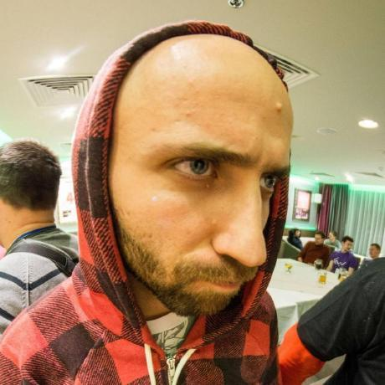
About Me
2008 - Developed first CMS website
2013 - Professional career as Symfony developer
2015 - 2018 - Working for integration BDD processes in big international company
TDD and BDD evangelist
GeekHub teacher in 3-8 seasons
Discover R and machine learning
https://github.com/spolischook

Slide 3
Two Common Issues
Building software right
Building right software

Slide 4
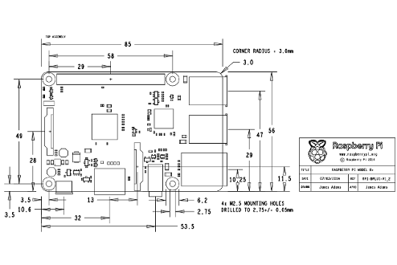
Building software right
Design Patterns
SOLID
Tests
Continuous Integration
Deploy
Semantic Versioning

Slide 5
Building right software
“According to the Standish Group’s CHAOS studies, on average some 45% of the features delivered into production are never used.”

Slide 6
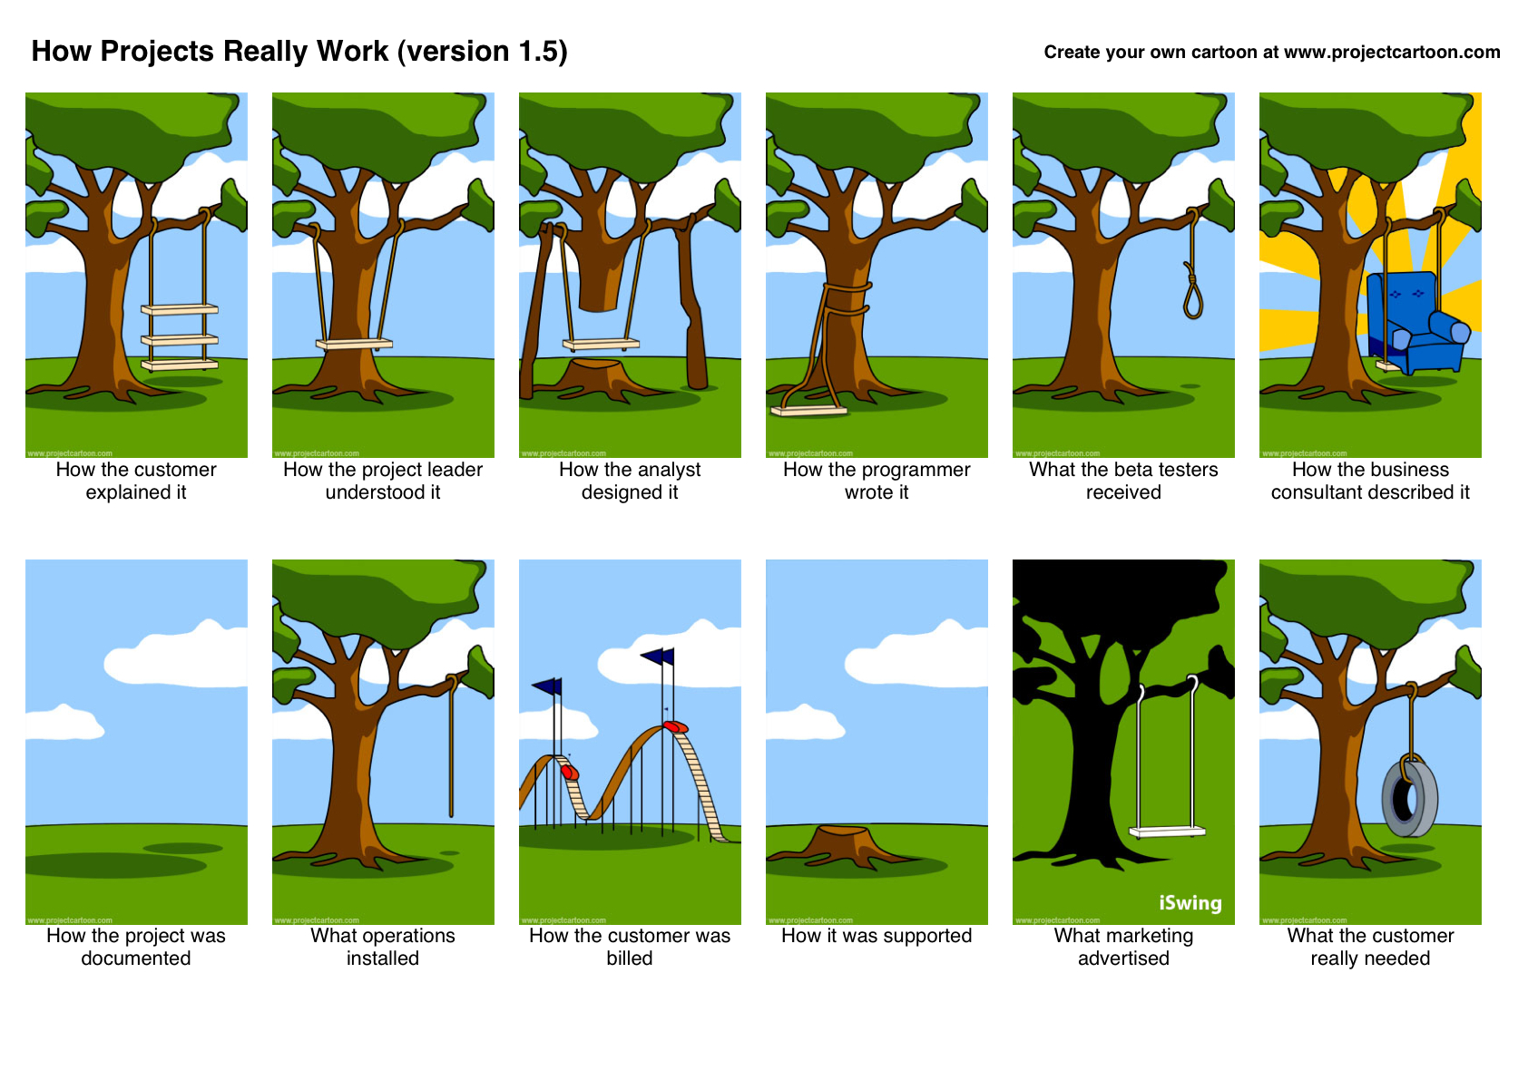
Building
right
software

Slide 7
Какие виды тестирования вы знаете?

Slide 8
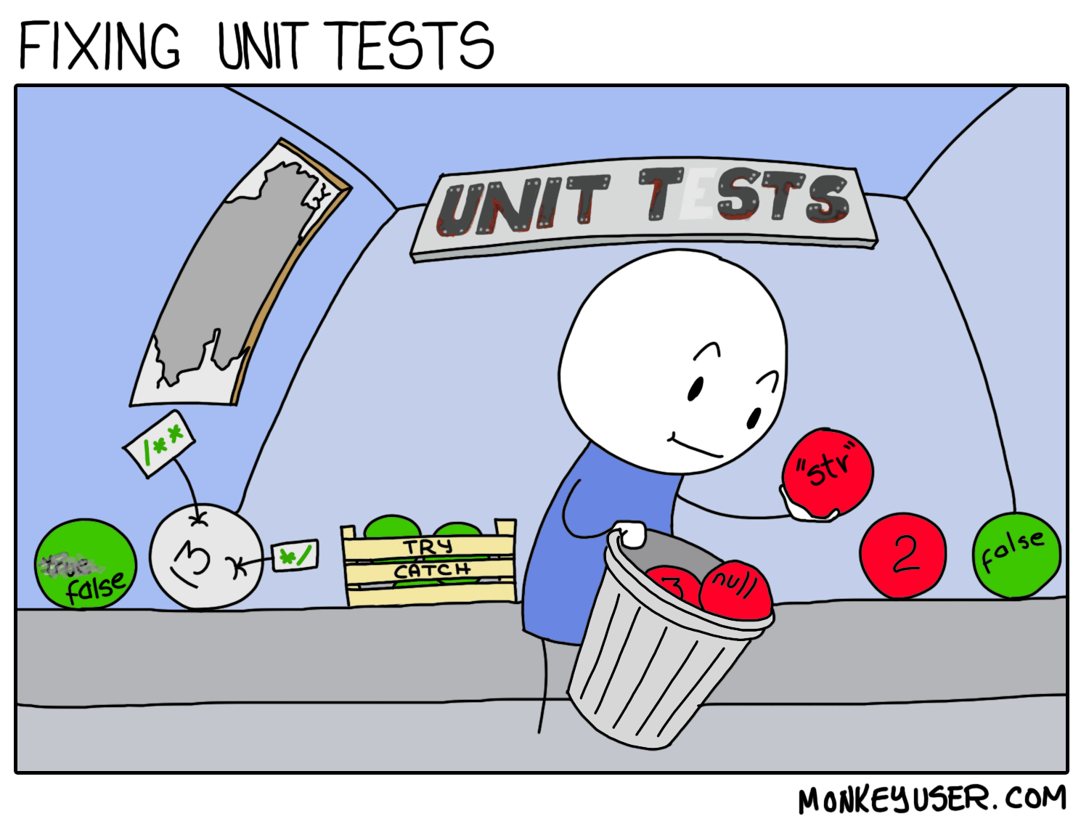
Unit tests

Slide 9
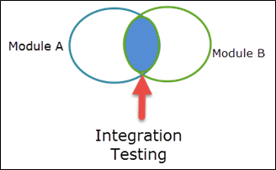
Functional tests

Slide 10
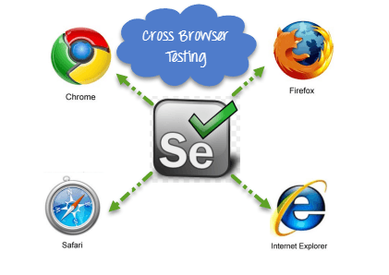
UI tests

Slide 11
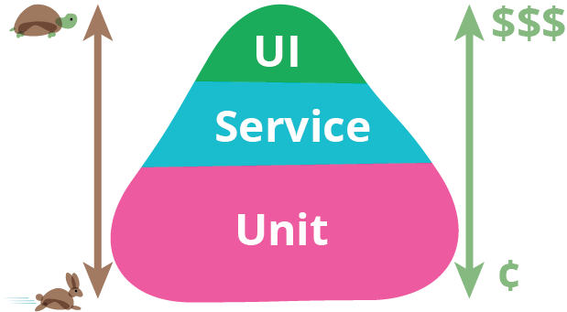
Стоимость тестов

Slide 12

Все тесты важны, все тесты нужны...

Slide 13
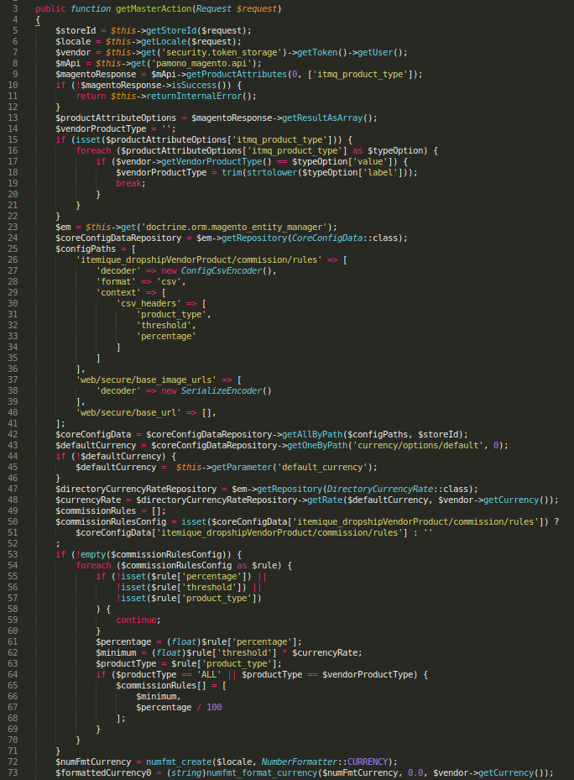
Как протестировать
ТТУК?

Slide 14

Смоук тесты

Slide 15
Чистые функции
Чистая функция — это функция, которая при одинаковых значениях аргументов всегда возвращает одинаковые значения и не имеет наблюдаемых побочных эффектов.
function doubleN(n) { if (typeof n !== 'number') return NaN return n * 2 }
https://medium.com/devschacht/robin-pokorny-do-pure-functions-exist-in-javascript-94fd25180fdc

Slide 16
Small functions that easy to cover with tests
/**
* @returns {string} a concatenation of module identifiers sorted
* @param {SortableSet} set to pull module identifiers from
*/
const getModulesIdent = set => {
set.sort();
let str = "";
for (const m of set) {
str += m.identifier() + "#";
}
return str;
};
https://github.com/webpack/webpack/blob/master/lib/Chunk.js

Slide 17

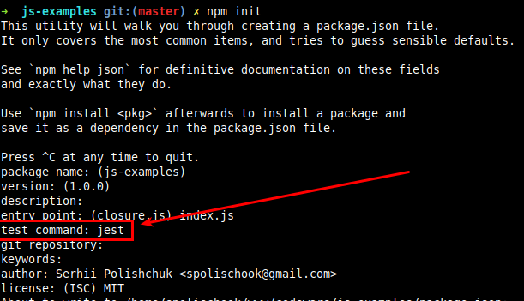
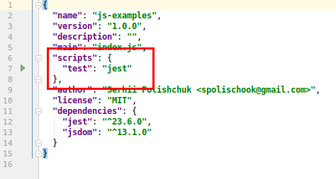
Jest - unit test library

Slide 18
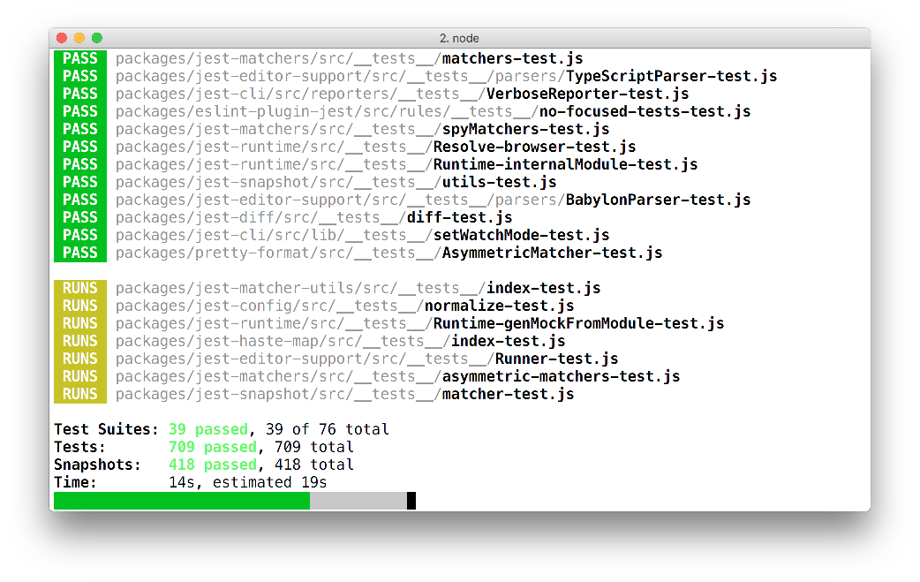
Jest - unit test library

Slide 19
Test example
function longestConsec(strarr, k) { let len = strarr.length, res = [] ; if (len === 0 || k > len || k <= 0) return ""; for (let i = 0; i <= len-k; i++) { res.push(strarr.slice(i, i+k).join("")); } return res.sort((a, b) => { return a.length < b.length; }).shift(); } expect(longestConsec(["it","wkppv","ixoyx", "zzzzzzzzzzzz", "3452"], 15)).toEqual(""); expect(longestConsec(["it","wkppv","ixoyx", "3452", "zzzzzzzzzzzz"], 0)).toEqual(""); expect(longestConsec([], 3)).toEqual(""); expect(longestConsec(["zone", "abigail", "theta", "form", "libe", "zas"], 2)).toEqual("abigailtheta");
https://www.codewars.com/kata/consecutive-strings

Slide 20
Test Approaches
TDD
TLD
BDD

Slide 21
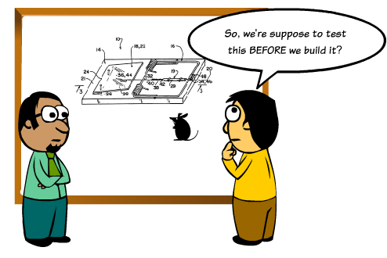
TLD. TDD.
Write tests before or after code?
Time required
Learning curve

Slide 22
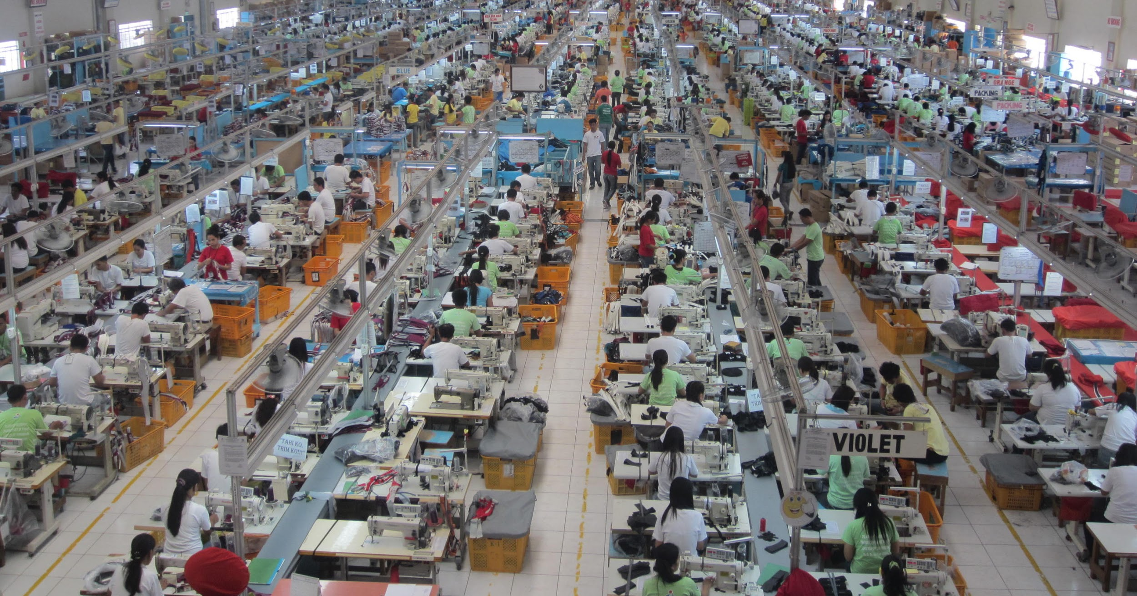
BDD

Slide 23
Who know everything about bugs?

Slide 24
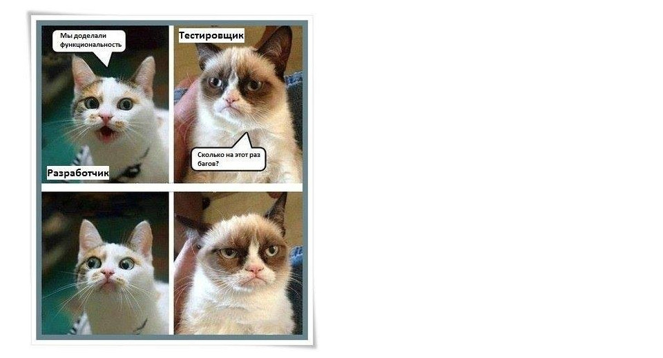
Who know everything
about bugs?
QA know what bugs will happen before developing will finished

Slide 25
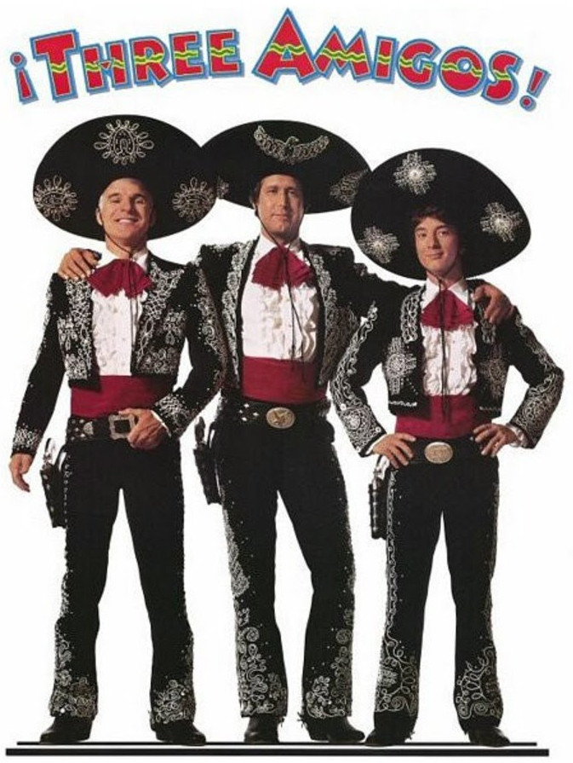
Finally we are all together
BI, QA and developer can understand each other better, using one unified language

Slide 26
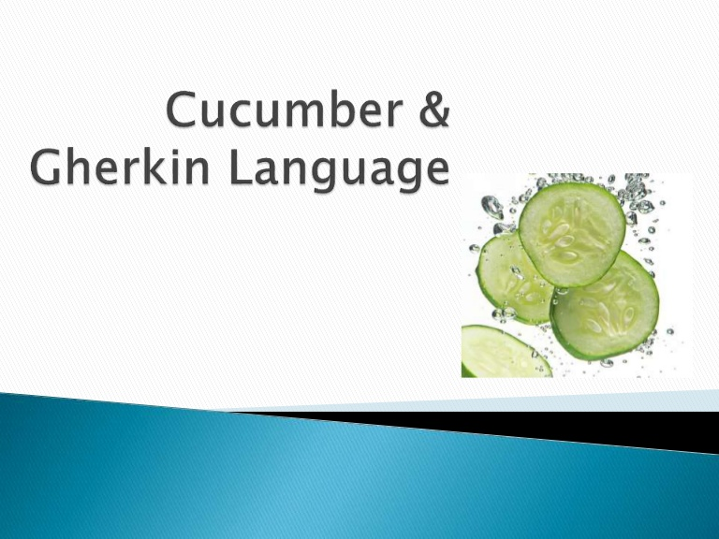
The most wrong thing that ever happen in BDD
10 years of Doing Behaviour-Driven Development All Wrong (part 1) by Liz Keogh https://youtu.be/2EM4itu7j7I (17:10)

Slide 27
Introducing Gherkin
The lenguage that we can use to discuss of behavior of your system
Feature: Refund item Scenario: Jeff returns a faulty microwave Given Jeff has bought a microwave for $100 And he has a receipt When he returns the microwave Then Jeff should be refunded $100

Slide 28
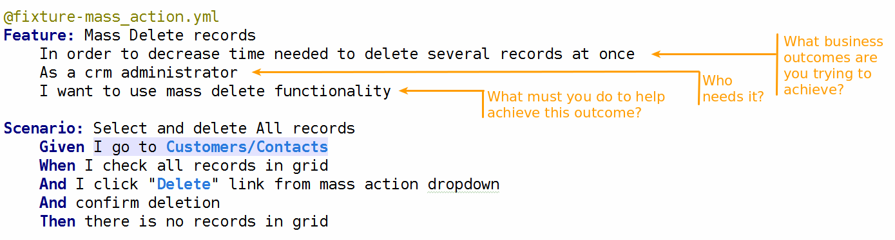
Gherkin syntax

Slide 29
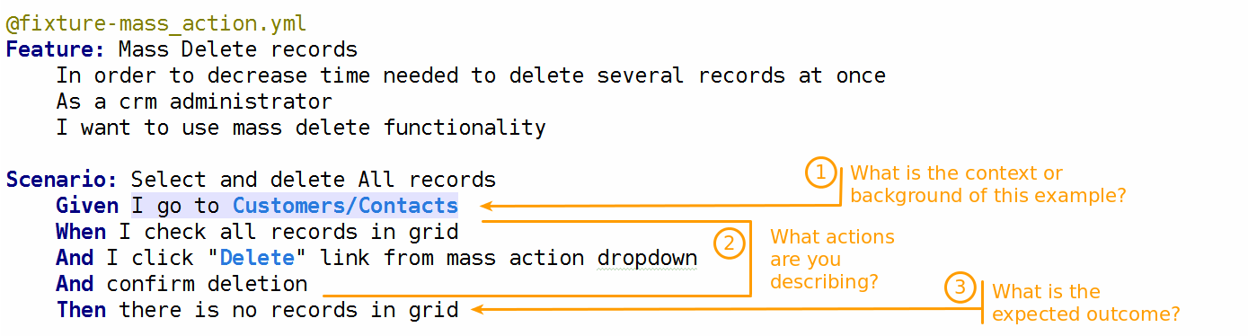
Gherkin syntax

Slide 30
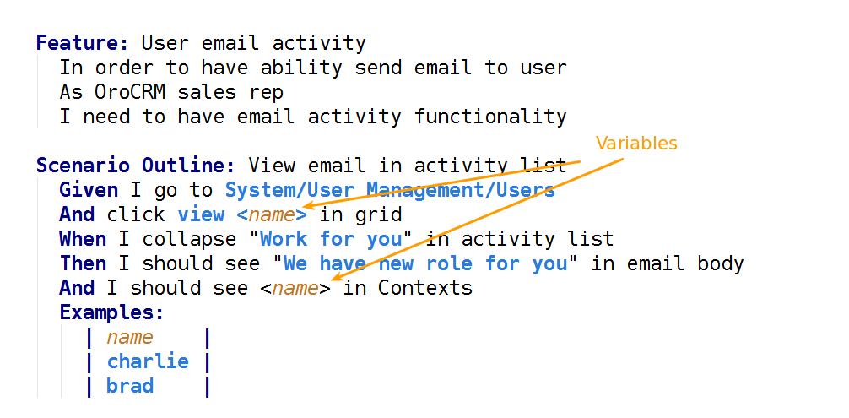
Gherkin syntax

Slide 31
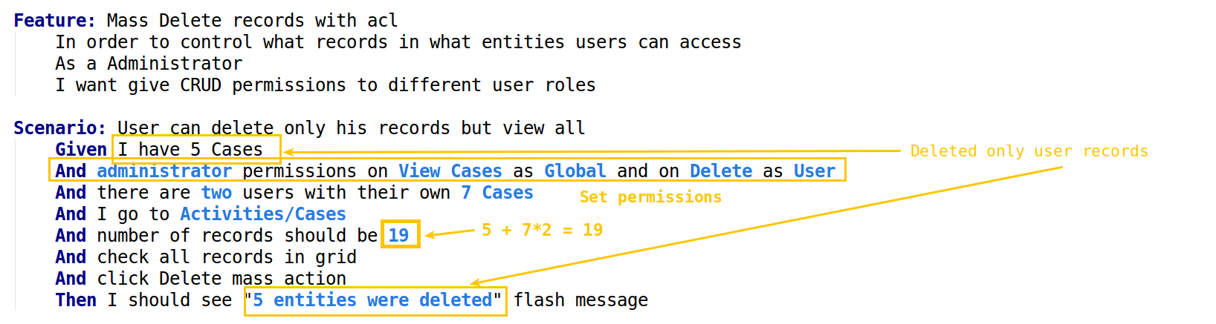
Gherkin syntax

Slide 32

Thank you for attention

Slide 33
REFERENCES
10 years of Doing Behaviour-Driven Development All Wrong by Liz Keogh https://www.youtube.com/watch?v=2EM4itu7j7I
Bdd in action by John Ferguson Smart https://www.manning.com/books/bdd-in-action
Interview with Dan North on Behavior-Driven Development https://www.youtube.com/watch?v=qWsnmx45734
About BDD at Liz Keogh official site https://lizkeogh.com/behaviour-driven-development/
Cucumber reference https://cucumber.io/docs/reference
http://blog.standishgroup.com/

